Slide 1

Paper Prototyping
Chapter 09

Slide 2
Topics
Benefits of Paper Prototypes
Paper Prototyping Tools
Example Paper Prototype
Constructing the Prototype
Playtest Questions
Best Uses of Paper Prototyping
Poor Uses of Paper Prototyping

Slide 3
Benefits of Paper Prototypes
Digital technologies have led to a whole new world of possibilities for game design.
But many designers still use paper prototypes to quickly implement and test new game ideas.
The two main reasons for this are:
Speed
Ease of implementation

Slide 4
Benefits of Paper Prototypes
Initial Development Speed
It is very fast to get from concept to playable prototype.
Digital games can take days (or at least several hours).
A simple paper prototype can be playable within 10 minutes.
Iteration Speed
In digital prototyping, changes take time, and the code must be carefully designed to be changeable.
In a paper prototype, you can even change the game in the middle of playing it.
Low Technical Barrier to Entry
Very little technical knowledge or artistic talent is required to make a paper prototype.
Therefore, anyone on your team can meaningfully contribute.

Slide 5
Benefits of Paper Prototypes
Collaborative Prototyping Process
Collaboratively creating a paper prototype is possible.
This can help your team learn to collaborate and share ideas.
It can also help all team members to feel a sense of ownership over and commitment to the project.
Focused Prototyping and Testing
A paper prototype is always very different from the final digital game.
This allows you to test specific aspects of the game without playtesters being distracted by the rest of the product.

Slide 6
Paper Prototyping Tools
Large Sheets of Paper
24" x 36" Post-it® sheets are particularly popular.
You can also find grid paper.
Dice
Get several dice of different kinds.
Normal RPG dice include 1d4, 2d6, 1d8, 1d12, 1d20, and percentile dice (2d10 with one marked 0-9 and the other 00-90).
Chapter 11, "Math and Game Balance" covers probability.
Cards
Cards are a very malleable random generator.
I recommend card sleeves.
Place a regular card in the sleeve with a slip of paper on top of it.

Slide 7
Paper Prototyping Tools
3x5 Note Cards
3" x 5" note cards can be used in several situations.
Brainstorming
Folding into pieces
Making quick card decks
Some designers are particularly fond of 3" x 2.5" half-cards.
Post-it® Notes
Great for quickly arranging and sorting ideas
Also for sticky flags to add to other game pieces
Whiteboard
Have lots of colors of markers available
Be sure to snap a photo of the board before erasing it!

Slide 8
Paper Prototyping Tools
Pipe Cleaners / LEGOs / Building Toys
Tools you can use to quickly build things.
A Notebook
Any designer should always have a notebook handy.
I use a pocket-sized Moleskine with unlined paper.
Small enough to carry / large enough to hold lots of ideas.
Take notes any time someone plays your prototype.
You always think you'll remember important details…
But that's often just not true.
Some people can use a digital notebook.
An iPad or other tablet
I carry both digital and paper notebooks.

Slide 9
Example Paper Prototype
Initial Digital Game Concept
Based on The Legend of Zelda for the Nintendo Entertainment System (NES)
Player explores a dungeon
Player explores a 2D, top-down dungeon
Real-time melee combat with enemies
Player finds a hookshot item that enables movement over previously impassable tiles

Slide 10
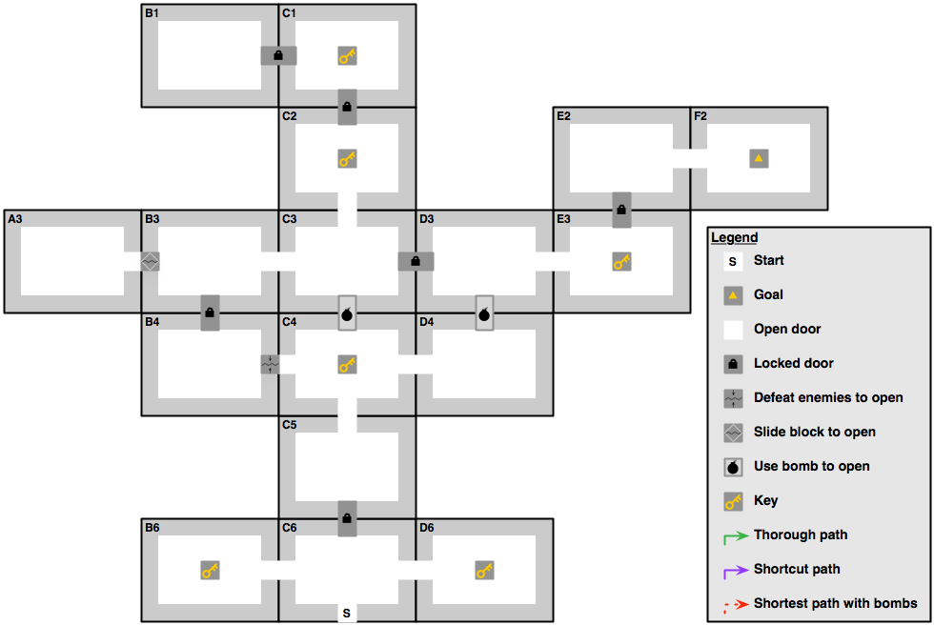
Legend of Zelda – First Dungeon – The Eagle
Dungeon Rules
Any Key can open any Lock
Bombs can open secret passages
Visit B1 to get Bow
Visit D3 to get Boomerang
F2 is the end goal
Try to Find
Without using bombs
Shortest path that visits all rooms
Shortest path that visits B1, D3, and F2
Using bombs
Shortest path to F2
Shortest path visiting B1, D3, and F2
Can you finish with extra keys?

Slide 11
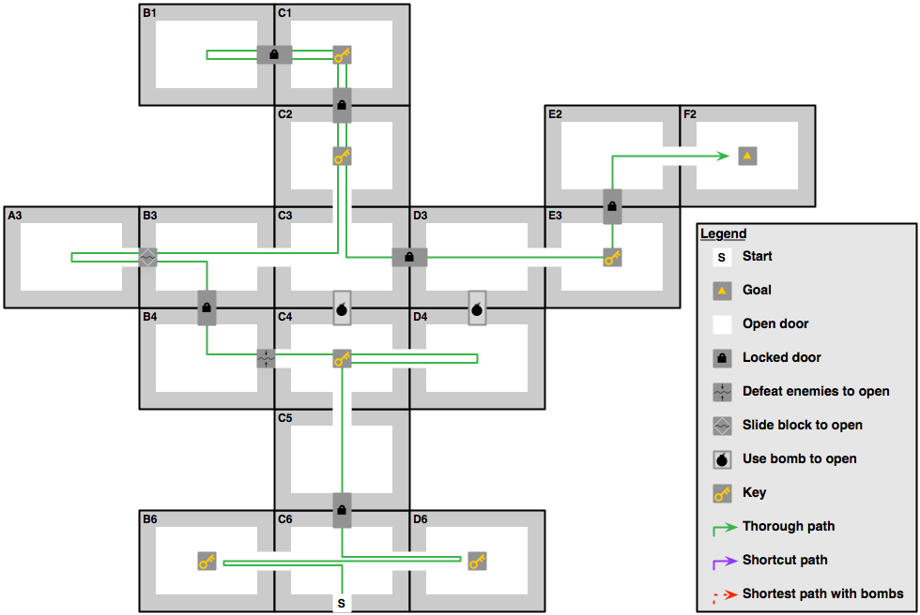
Legend of Zelda – First Dungeon – The Eagle
Dungeon Rules
Any Key can open any Lock
Bombs can open secret passages
Visit B1 to get Bow
Visit D3 to get Boomerang
F2 is the end goal
Try to Find
Without using bombs
Shortest path that visits all rooms
Shortest path that visits B1, D3, and F2
Using bombs
Shortest path to F2
Shortest path visiting B1, D3, and F2
Can you finish with extra keys?

Slide 12
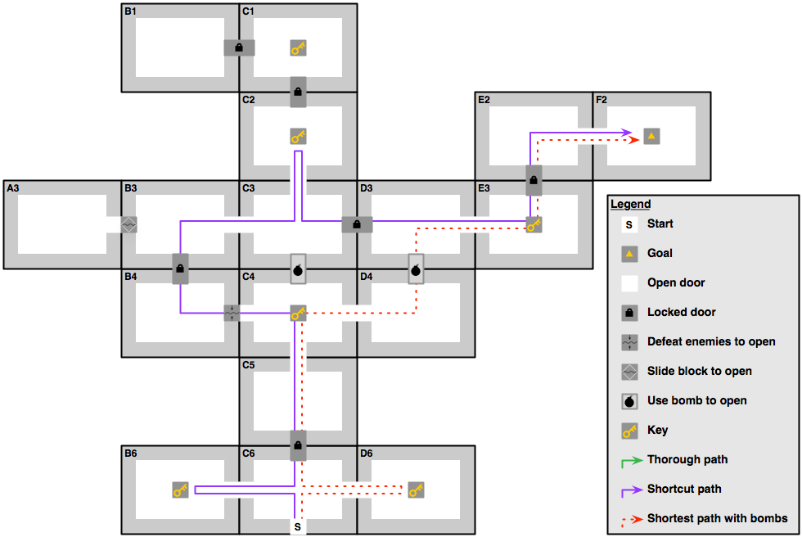
Legend of Zelda – First Dungeon – The Eagle
Purple Shortcut Path
Uses no Bombs
Gets Boomerang in D3
Does not acquire Bow in B1
Could get extra key in D6
Red Shortcut Path
Uses 1 Bomb
Gets Boomerang in D3
Does not acquire Bow in B1
Could get extra key in B6
Would then leave with 2 extra keys

Slide 13
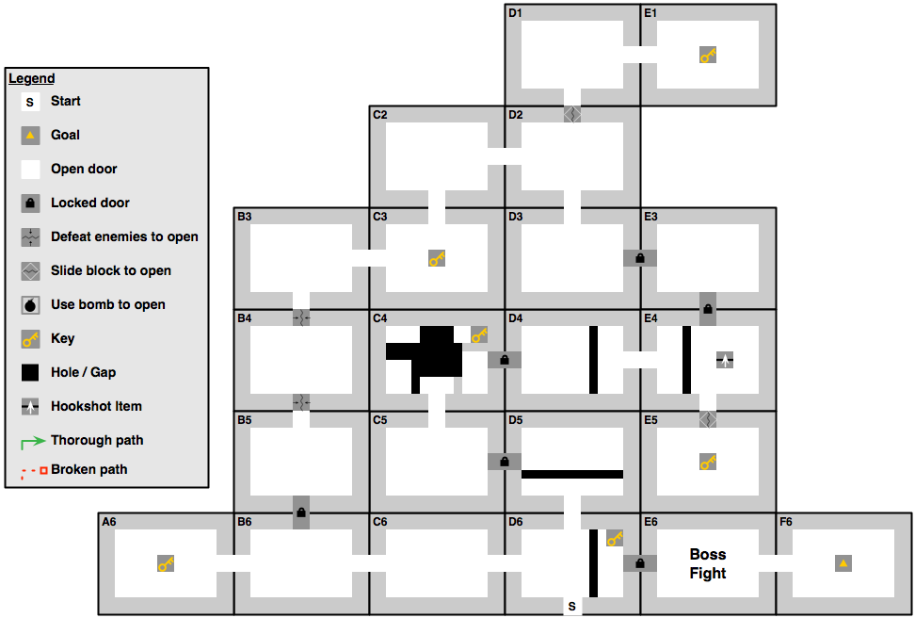
Legend of Zelda – Prototype Dungeon – The Hat
New Traversal Mechanic
Hookshot found in E4
Allows player to cross black gaps
C4, D4, E4, D5, and D6
To Prototype Exploration:
Use individual cards
Lay cards down as player enters rooms

Slide 14
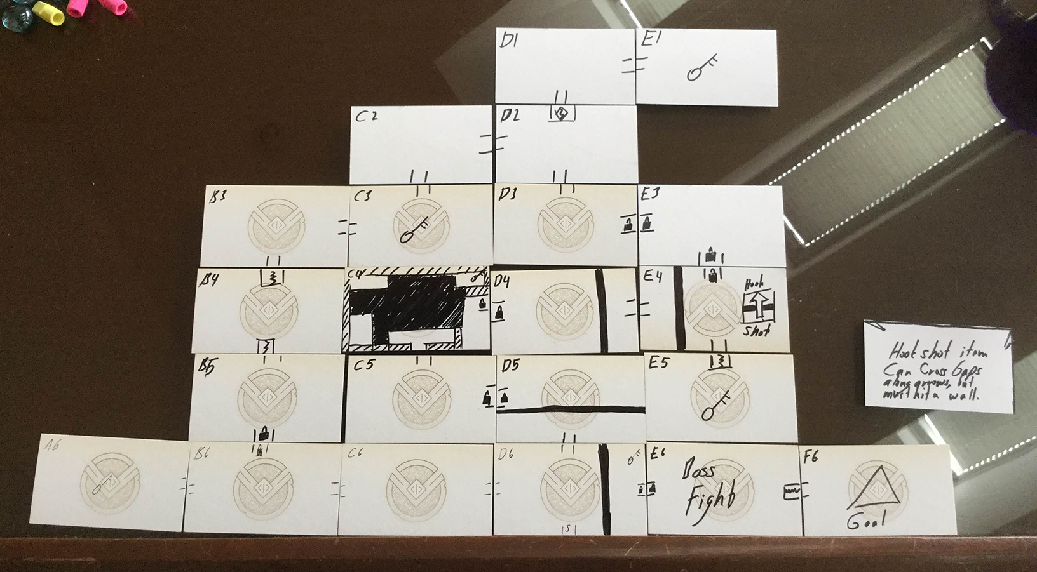
Legend of Zelda – Prototype Dungeon – The Hat

Slide 15
Legend of Zelda – Prototype Dungeon – The Hat
New Traversal Mechanic
Hookshot found in E4
Allows player to cross black gaps
C4, D4, E4, D5, and D6
To Prototype Exploration:
Use individual cards
Lay cards down as player enters rooms
Try to Find
Shortest path that visits all rooms
Shortest path to F6 (Goal)

Slide 16
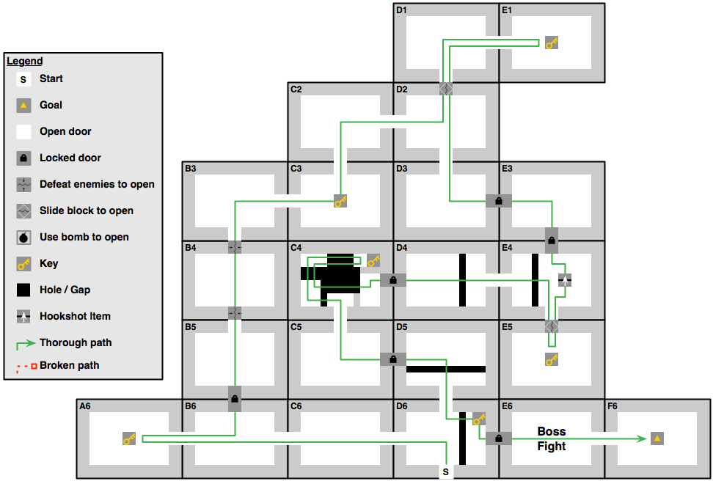
Legend of Zelda – Prototype Dungeon – The Hat
New Traversal Mechanic
Hookshot found in E4
Allows player to cross black gaps
Gaps in C4, D4, E4, D5, and D6
To Prototype Exploration:
Use individual cards
Try to Find
Shortest path that visits all rooms
Shortest path to F6 (Goal)

Slide 17
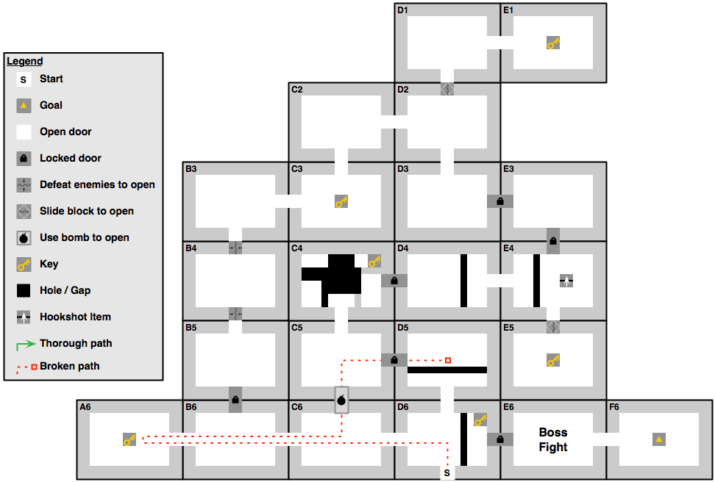
Legend of Zelda – Prototype Dungeon – The Hat
Shortcuts Can Break Levels
Single Bomb Wall
Allows player to get stuck!

Slide 18
Legend of Zelda – Eagle Dungeon
First Dungeon in The Legend of Zelda

Slide 19
Playtest Questions
When you run the playtest, think about these questions:
Did the map layout work? Why do you think it did or didn't?
Is the player following a path that surprises you?
Is it possible for her to get herself stuck?
Is the player having fun?
The level should be fun to explore, even as a paper prototype.
Be sure to write down all of these answers!
More on testing in Chapter 10, "Game Testing"

Slide 20
Best Uses of Paper Prototyping
Understanding player movement through space
Players tend to choose similar paths through space.
Understanding player flow through space will help you in all aspects of level design.
Balancing simple systems
These weapons are all based on three simple variables:
Accuracy over distance / Number of shots / Damage per shot
Balancing each weapon against the others can be complex:
Shotgun: 6 damage per shot, will kill an enemy with one shot
At a range of 1 to 4, any roll other than 1 will hit
But if that shot misses, the enemy will take no damage at all
Machine Gun: 1 damage per shot (6 shots must hit to kill an enemy)
At a range of 1 to 4, any roll above 3 will hit
With 10 shots, it is much more likely that you will get close to the average damage of the gun at that distance (5 points)

Slide 21
Best Uses of Paper Prototyping
Graphical User Interface (GUI)
Print several mock-ups of a GUI (i.e., buttons, menus, input fields).
Ask testers which buttons they would press to accomplish a certain task (e.g., pausing the game, picking a character).
Trying wild ideas
Trying a crazy rule every once in a while to see how it changes gameplay is easy.
What if interception fire happened once for every step taken by a moving player?
What if attackers got a damage or to-hit bonus for firing on a target that was unaware of them (that is, that couldn't see them)?
These are easy questions to answer with a paper prototype.

Slide 22
Poor Uses of Paper Prototyping
Tracking lots of information
Several things in the prototype could have been handled better by a computer:
Visibility calculations
Tracking health
Counting how many spaces an attacker is from a target
And so on
Paper prototype should focus on simple systems in a game:
Level layout
The general feel of each weapon
The "risky" shotgun and the "reliable" machine gun
Fine-tune this information later with the digital prototype

Slide 23
Poor Uses of Paper Prototyping
Game rhythm for fast or slow games
Paper prototypes can give a false impression of game rhythm if the game will be played much more quickly or more slowly than the paper prototype.
If this were an action game, the player would have a lot less time for thought and strategizing in the real game than the prototype.
Physical interface
Paper prototypes work well for GUIs but have very little to tell us about physical interfaces.
Gamepad controllers / Touchscreens / Keyboard and Mouse / And so on
Only a digital prototype can test the actual physical interface that will be used by the player.

Slide 24
Chapter 9 – Summary
Paper prototypes are quick and easy to implement.
They are great testbeds for game ideas.
They also teach you not to be discouraged if your design isn't all that great.
Just make another prototype with a different idea!
Next chapter:
One of the most important aspects of game design is testing.
The next chapter covers several different types of game testing and shows you how to run them.

